Slide 1
Value of NOAA Satellites and Related Sciences

Slide 2
Societal Impacts of NOAA

Slide 3
Data and information available at http://www.ppi.noaa.gov/economics/societal-impacts/

Slide 4
Improved Tropical Cyclone Forecasts – Technological Assumptions

Slide 5
Annual savings for Tropical Cyclones

Slide 6
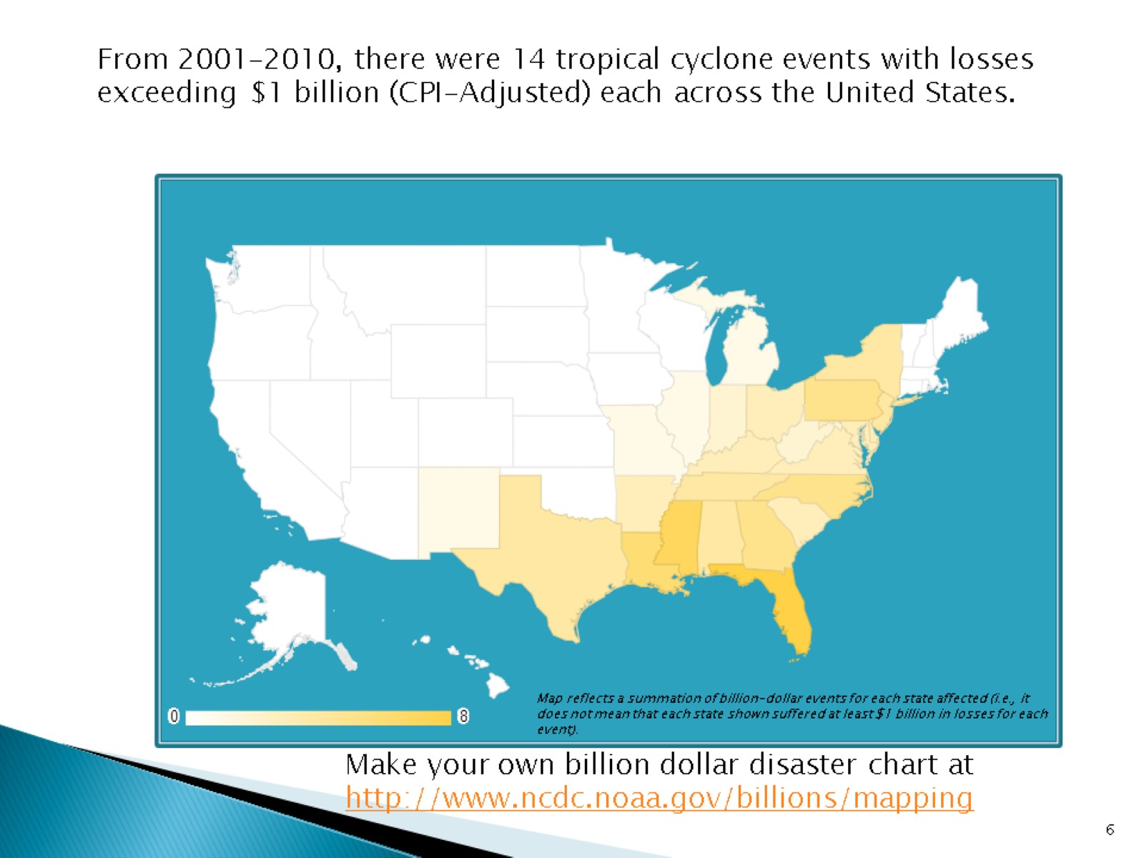

Slide 7
Sectors with expected benefits from improved geostationary satellite data are:

Slide 8
Updated Cost-Benefit Analysis

Slide 9
Polar satellite values (METOP)

Slide 10
US Industries, Personal Valuation

Slide 11
US Property

Slide 12
Exercise for the reader…

